Slide 1


Trend Tracker
Team:
Akshata.T.Rathod
Inchara Poovaiah.A
Jnaneshwari.R
Kavana.N

Slide 2
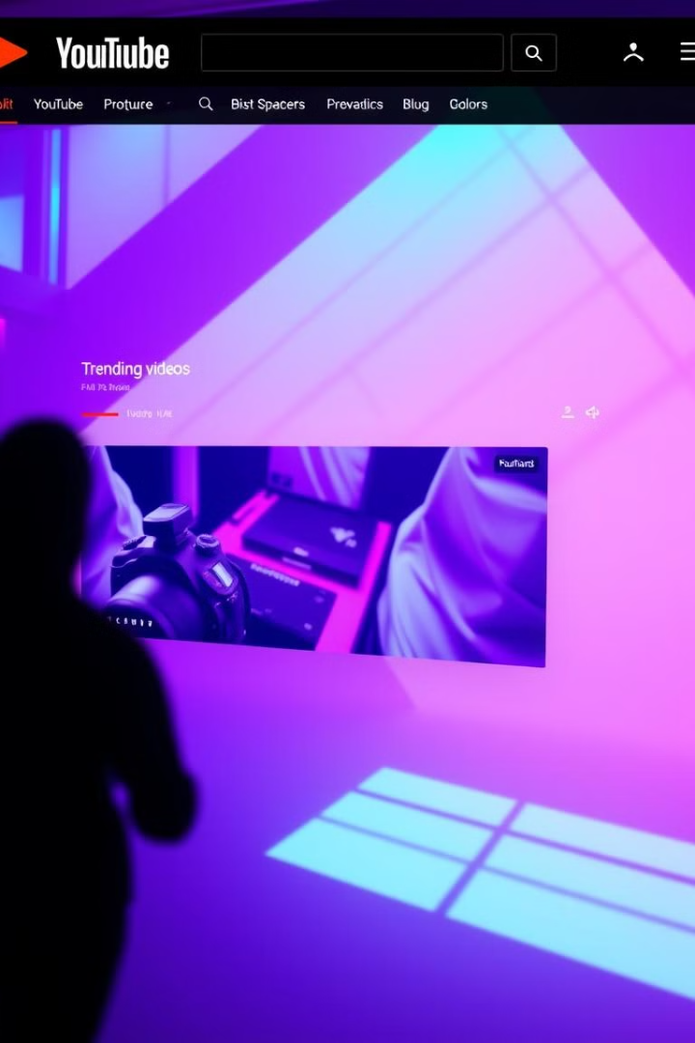
YouTube Trending Video Analysis
YouTube is the world's most popular video platform, with a constantly updated list of trending videos.It analyzes video content, engagement,and audience metrics, providing insights into social media behavior and cultural trends. This analysis informs content creation, marketing, and business decisions, utilizing tools like YouTube Analytics, Google Trends, and VidIQ.

Slide 3
Problem Statement:
YouTube trending videos gain massive visibility, but the factors influencing their popularity remain unclear. This analysis aims to identify key characteristics of trending videos in India by examining viewership patterns, engagement metrics, title formatting, content categories, and publishing trends. By analyzing 37,000+ trending videos over 205 days, we seek to uncover insights that can help creators optimize their content strategy to maximize their chances of making it to the trending list.

Slide 4
Objectives of the Youtube Trending Video Analysis:
Analyze Engagement Metrics
Identify Longest-Trending Videos
Examine Title Formatting Impact
Extract Common Patterns in Titles
Determine Top-Performing Channels and Categories
Study Publishing Trends

Slide 5
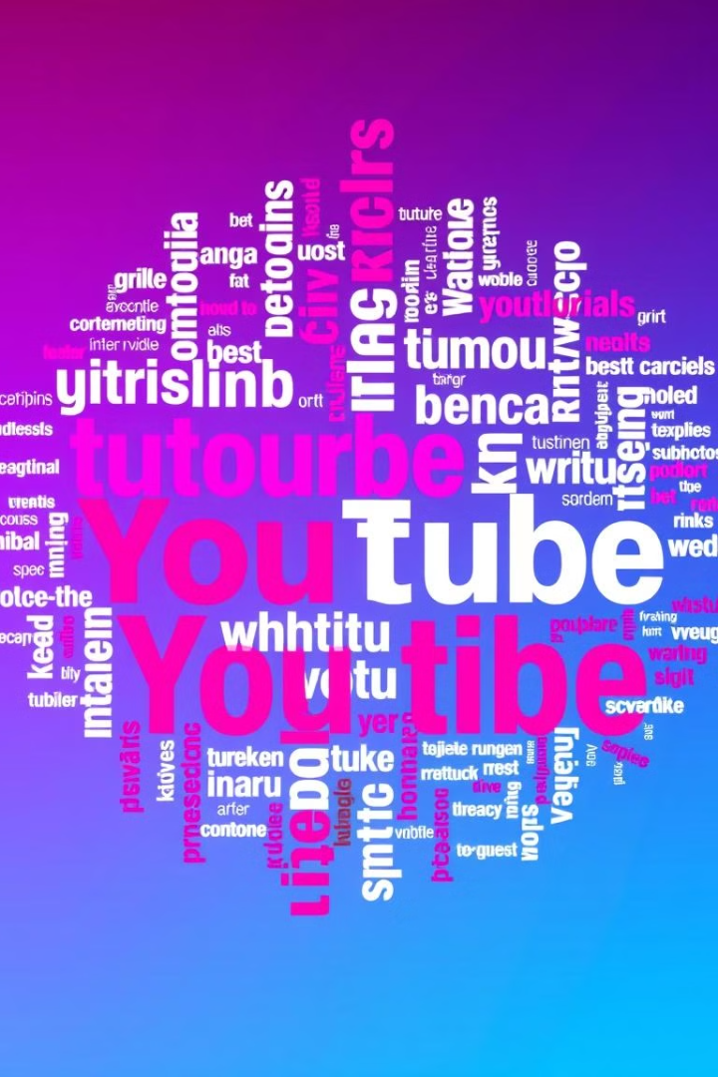
Video Recurrence and Title Characteristics
Recurring Videos
Optimal Title Length
The dataset contains 37,352 entries, but only 16,307 unique videos, indicating that many videos appear on the trending list for multiple days.
Trending videos with 60 million views or more tend to have titles between 50 and 55 characters, suggesting an optimal title length for maximum impact.
Common Title Elements
Delimiters like "|" and "-" are frequently used in trending video titles, along with words such as Official, Video, Trailer, Episode, Song, and 2018.

Slide 6
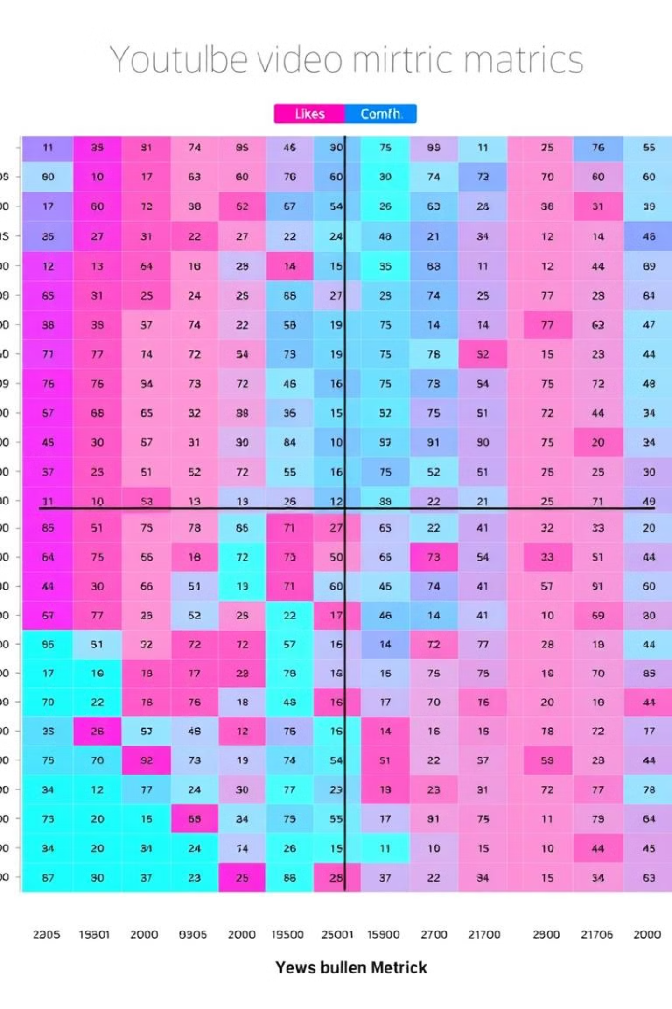



Correlation Analysis: Views, Likes, and Comments
Views and Likes
Likes and Comments
Dislikes and Comments
A strong positive correlation exists between the number of views and the number of likes, indicating that videos with more views tend to receive more likes, and vice versa.
There is a strong positive correlation between the number of likes and the number of comments, suggesting that videos with high like counts also tend to generate more discussion.
A slightly weaker positive correlation is observed between the number of dislikes and the number of comments, implying that controversial videos may also spark more discussion.

Slide 7



Top Channels and Categories
Analyze Category Distribution
Identify the video categories (e.g., Entertainment, Gaming, Comedy) with the highest number of trending videos, revealing popular content niches.
Analyze Publication Timing
Determine the optimal time to publish the videos.

Slide 8
Workflow Overview
1.Data Collection & Preparation
Imported the dataset 📂
Cleaned missing values & standardized formats ✅
Extracted useful details like year, title length, and publishing time
2.Exploratory Data Analysis (EDA)
Views, Likes, & Comments: Checked how many views, likes, and comments trending videos get 📊
Numerical & Non-Numerical Data: Explored both types of information
Capitalized Words in Titles: Analyzed if capitalized words impact a video's trend status 🔠
3.Deeper Insights
Most Common Words: Found popular words in trending video titles 🏷️
Top YouTube Channels: Identified channels with the most trending videos 🎥
Trending Categories: Determined which video categories (Entertainment, Gaming, etc.) trend the most
4.Other Key Findings
Checked publishing times & days to see when videos are most likely to trend ⏰
Investigated errors, disabled comments, and ratings for trends in restricted content 🚫

Slide 9
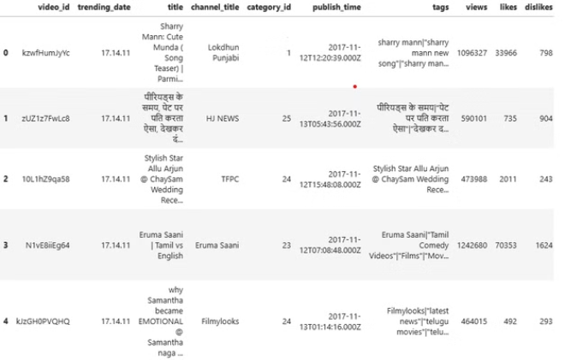
Code Snippets:
Reading the dataset
df = pd.read_csv('./dataset/INvideos.csv')
Let's get a feel of what our dataset looks like by displaying its first few rows
df.head()

Slide 10
Dataset Collection Year
cdf = df["trending_date"].apply(lambda x: '20' + x[:2]).value_counts().to_frame().reset_index().rename(columns={"index": "year", "trending_date": "No_of_videos"})
fig, ax = plt.subplots()
_ = sns.barplot(x="year", y="No_of_videos", data=cdf,
palette=sns.color_palette(['#ff764a', '#ffa600'], n_colors=7), ax=ax)
_ = ax.set(xlabel="Year", ylabel="No. of videos")
Views Histogram
fig, ax = plt.subplots()
_ = sns.distplot(df["views"], kde=False, color=PLOT_COLORS[4], hist_kws={'alpha': 1}, bins=np.linspace(0, 2.3e8, 47), ax=ax)
_ = ax.set(xlabel="Views", ylabel="No. of videos", xticks=np.arange(0, 2.4e8, 1e7))
_ = ax.set_xlim(right=2.5e8)
_ = plt.xticks(rotation=90)
Likes Histogram
plt.rc('figure.subplot', wspace=0.9)
fig, ax = plt.subplots()
_ = sns.distplot(df["likes"], kde=False,
color=PLOT_COLORS[4], hist_kws={'alpha': 1},
bins=np.linspace(0, 6e6, 61), ax=ax)
_ = ax.set(xlabel="Likes", ylabel="No. of videos")
_ = plt.xticks(rotation=90)
Comment Count Histogram
fig, ax = plt.subplots()
_ = sns.distplot(df["comment_count"], kde=False, rug=False,
color=PLOT_COLORS[4], hist_kws={'alpha': 1}, ax=ax)
_ = ax.set(xlabel="Comment Count", ylabel="No. of videos")

Slide 11
Publishing Time
cdf = df["publishing_day"].value_counts()\
.to_frame().reset_index().rename(columns={"index": "publishing_day", "publishing_day": "No_of_videos"})
fig, ax = plt.subplots()
_ = sns.barplot(x="publishing_day", y="No_of_videos", data=cdf,
palette=sns.color_palette(['#003f5c', '#374c80', '#7a5195',
'#bc5090', '#ef5675', '#ff764a', '#ffa600'], n_colors=7), ax=ax)
_ = ax.set(xlabel="Publishing Day", ylabel="No. of videos")
Largest Number of Trending Videos
cdf = df["category_name"].value_counts().to_frame().reset_index()
cdf.rename(columns={"index": "category_name", "category_name": "No_of_videos"}, inplace=True)
fig, ax = plt.subplots()
_ = sns.barplot(x="category_name", y="No_of_videos", data=cdf,
palette=sns.cubehelix_palette(n_colors=16, reverse=True), ax=ax)
_ = ax.set_xticklabels(ax.get_xticklabels(), rotation=90)
_ = ax.set(xlabel="Category", ylabel="No. of videos")
Capitalized Words
def contains_capitalized_word(s):
for w in s.split():
if w.isupper():
return True
return False
df["contains_capitalized"] = df["title"].apply(contains_capitalized_word)
value_counts = df["contains_capitalized"].value_counts().to_dict()
fig, ax = plt.subplots()
_ = ax.pie([value_counts[False], value_counts[True]], labels=['No', 'Yes'],
colors=[PLOT_COLORS[4], '#ffa600'], textprops={'color': '#040204'}, startangle=45)
_ = ax.axis('equal')
_ = ax.set_title('Capitalized Word?')
Corrrelation
h_labels = [x.replace('_', ' ').title() for x in
list(df.select_dtypes(include=['number', 'bool']).columns.values)]
fig, ax = plt.subplots(figsize=(10,6))
_ = sns.heatmap(df.corr(), annot=True, xticklabels=h_labels, yticklabels=h_labels, cmap=sns.cubehelix_palette(as_cmap=True), ax=ax)

Slide 12
Publishing Hour
cdf = df["publishing_hour"].value_counts().to_frame().reset_index()\
.rename(columns={"index": "publishing_hour", "publishing_hour": "No_of_videos"})
fig, ax = plt.subplots()
_ = sns.barplot(x="publishing_hour", y="No_of_videos", data=cdf,
palette=sns.cubehelix_palette(n_colors=24), ax=ax)
_ = ax.set(xlabel="Publishing Hour", ylabel="No. of videos")
Views Title Lengths
fig, ax = plt.subplots()
_ = ax.scatter(x=df['views'], y=df['title_length'], color=PLOT_COLORS[2], edgecolors="#000000", linewidths=0.5)
_ = ax.set(xlabel="Views", ylabel="Title Length")
Word Cloud
wc = wordcloud.WordCloud(width=1200, height=500,
collocations=False, background_color="white",
colormap="tab20b").generate(" ".join(title_words))
plt.figure(figsize=(15,10))
plt.imshow(wc, interpolation='bilinear')
_ = plt.axis("off")
Largest number of trending videos
cdf = df.groupby("channel_title").size().reset_index(name="video_count") \
.sort_values("video_count", ascending=False).head(20)
fig, ax = plt.subplots(figsize=(8,8))
_ = sns.barplot(x="video_count", y="channel_title", data=cdf,
palette=sns.cubehelix_palette(n_colors=20, reverse=True), ax=ax)
_ = ax.set(xlabel="No. of videos", ylabel="Channel")

Slide 13

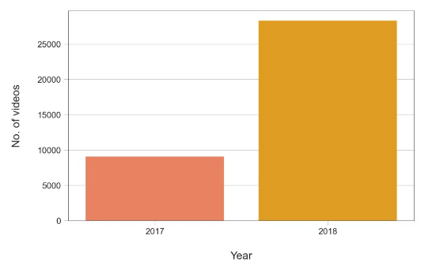
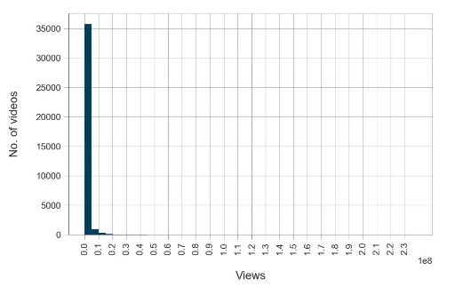
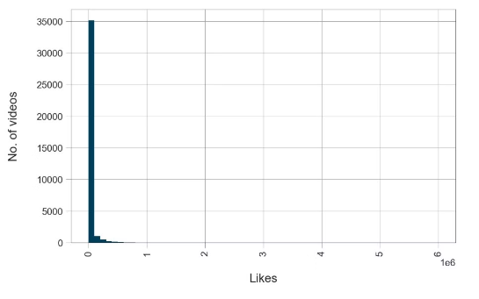
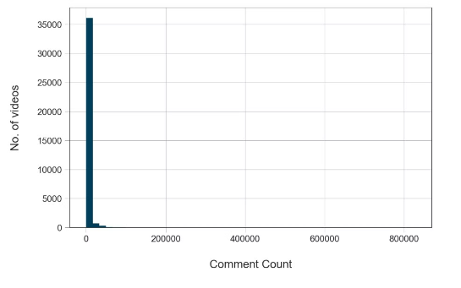
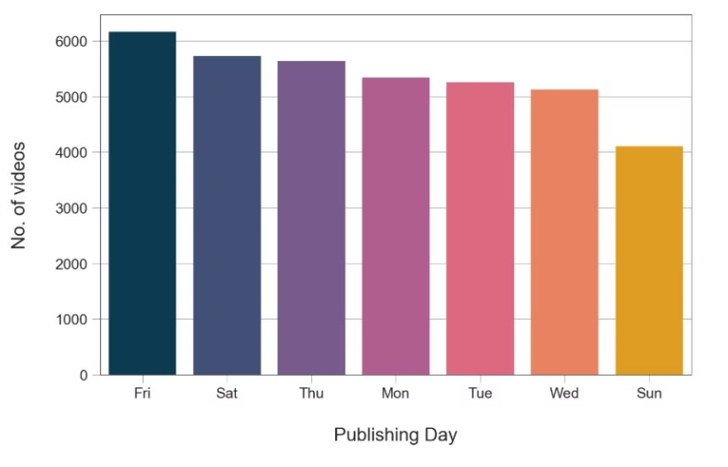
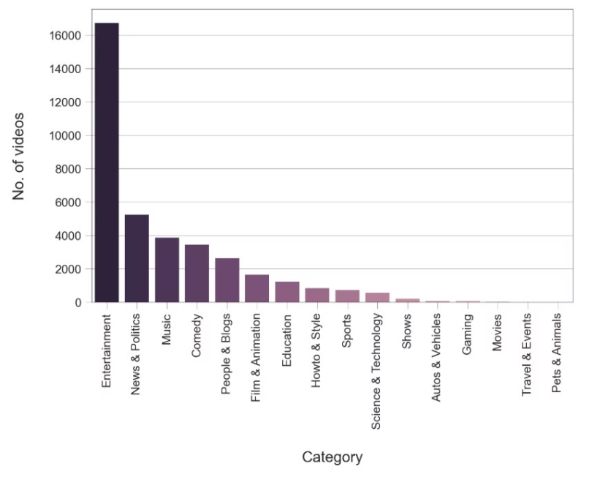
Project Output Snapshots:
Dataset Collection Year
Views Histogram
Likes Histogram
Comment Count Histogram
Publishing time
Largest number of trending videos

Slide 14
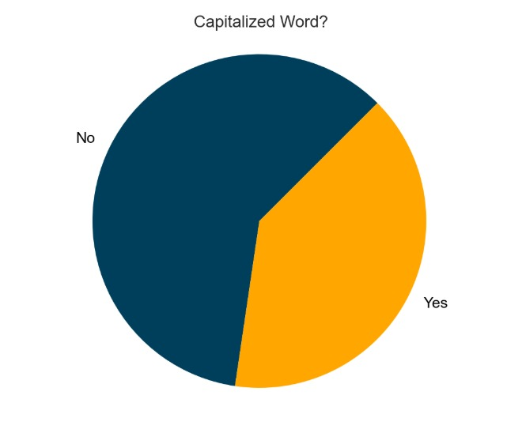
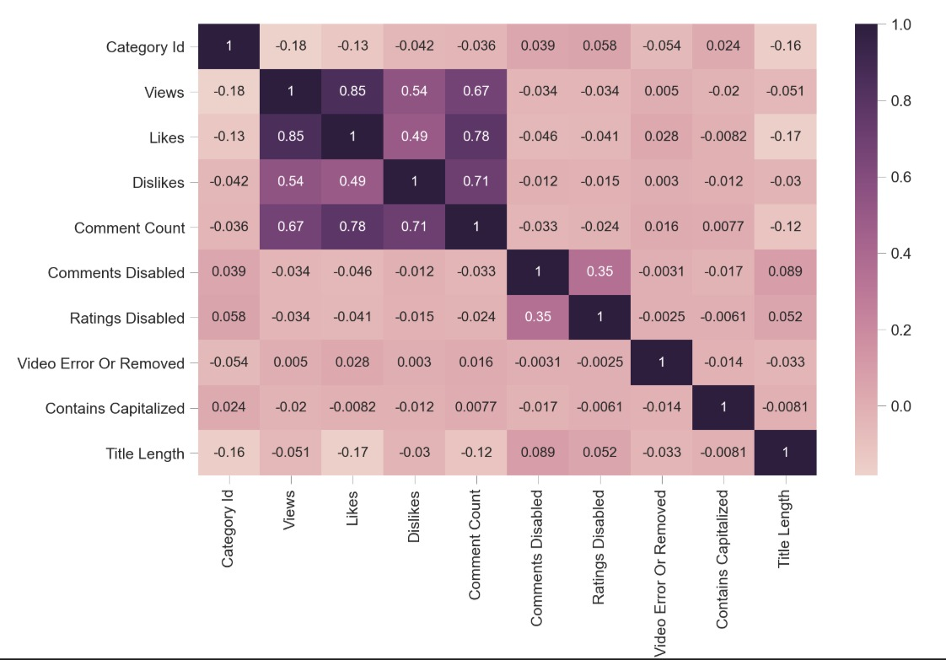
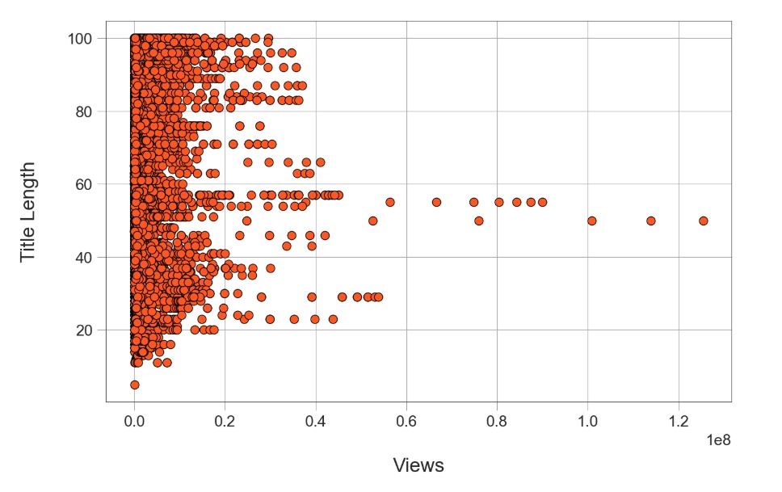
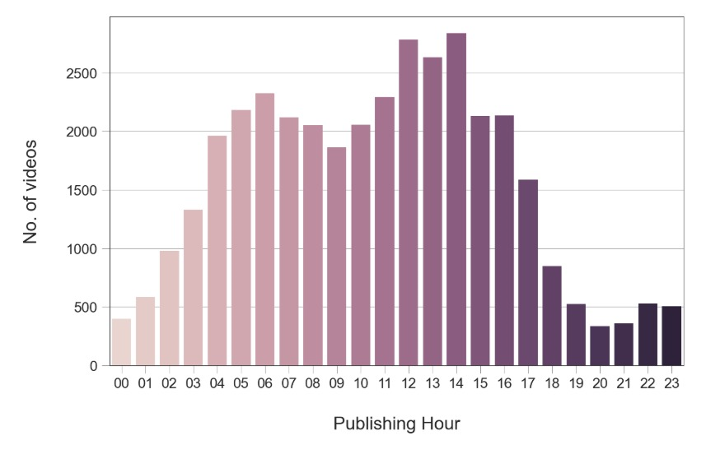
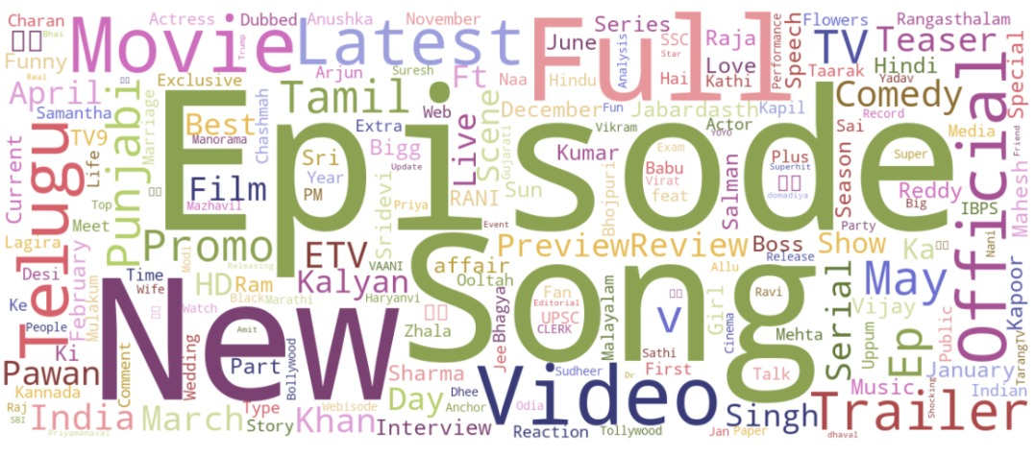
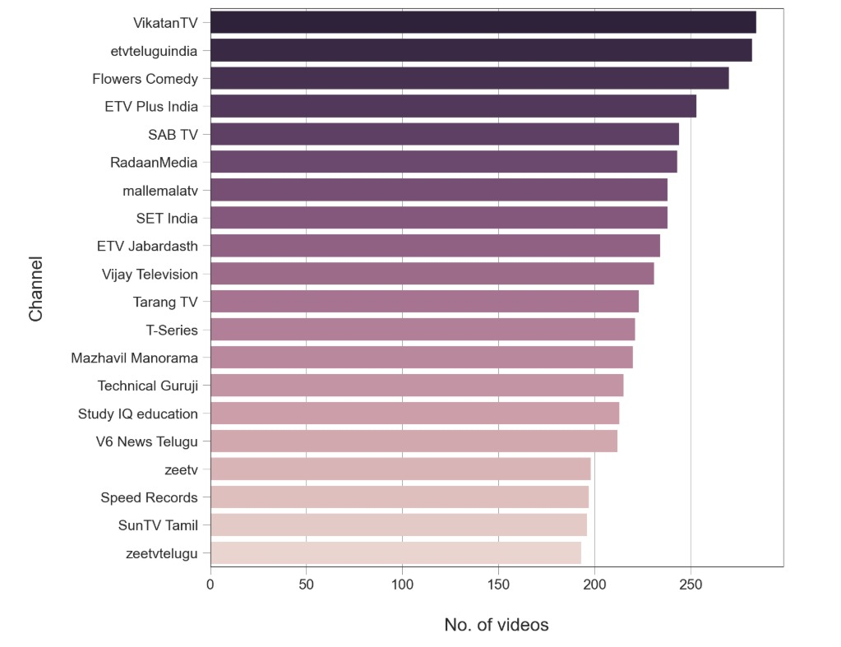
Capitalized words
Correlation
Views Title Lengths
Publishing hour
Word Cloud
Largest number of trending videos

Slide 15

Conclusion:
We analyzed a dataset that contains information about YouTube trending videos for 205 days. The dataset was collected in 2017 and 2018 and contains 37352 video entries.
86% of trending videos have less than 1.5 million views, and 95% have less than 5 million views.
87% of trending videos have less than 40,000 likes, and 94% have less than 100,000 likes.
88% of trending videos have less than 3,500 comments, and 97% have less than 25,000 comments.
Some videos may appear on the trending videos list on more than one day. Our dataset contains 37352 entries but not for 37352 unique videos but for 16307 unique videos.
Trending videos that have 60,000,000 views and more have title length between 50 and 55 characters approximately.
The delimiters | and - were common in trending video titles.
The words Official, Video, Trailer, Episode, Song and 2018 were common also in trending video titles.
There is a strong positive correlation between the number of views and the number of likes of trending videos: As one of them increases, the other increases, and vice versa.
There is a strong positive correlation also between the number of likes and the number of comments, and a slightly weaker one between the number of dislikes and the number of comments.

Slide 16
ThankYou

